Slide 1
IUNotifier Application Project Note

Slide 2
Agenda
Release Note
Login use case
Logout use case
Reading News use cases
Getting Events information use case
Push Notification use case
Development Note
Class Diagram
Sequence Diagrams
Sample Java source
Sample Java test source
Demo

Slide 3
Release Note

Slide 4
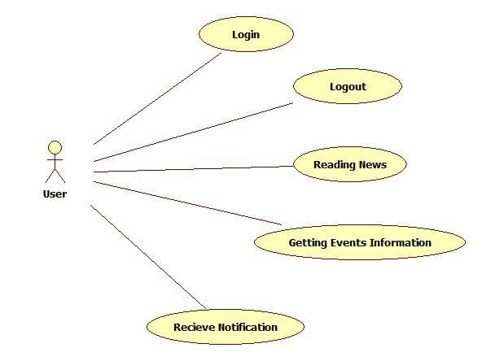
Use case diagram

Slide 5
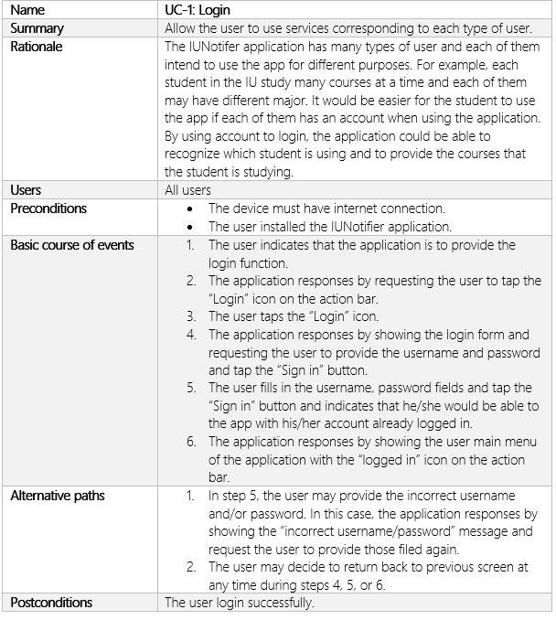
Login use case

Slide 6
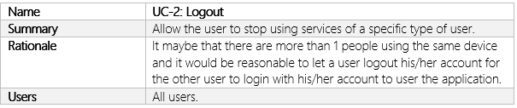
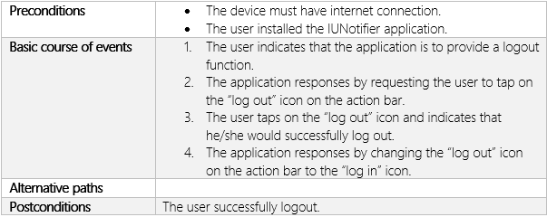
Logout use case

Slide 7
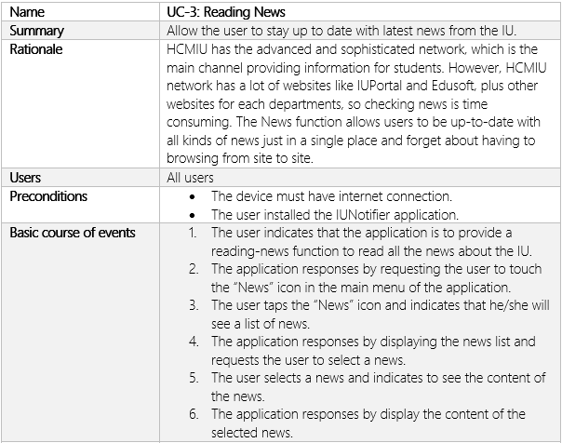
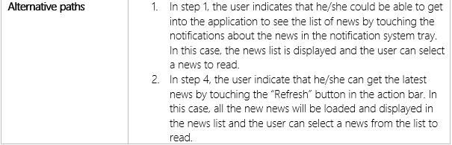

Reading News use case

Slide 8
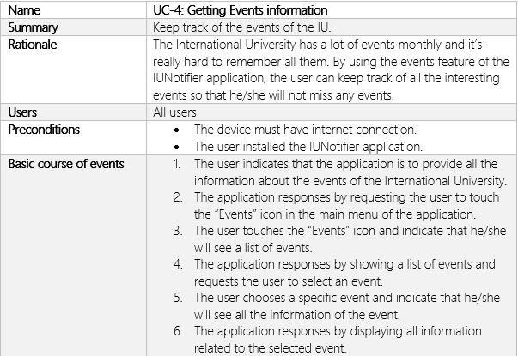
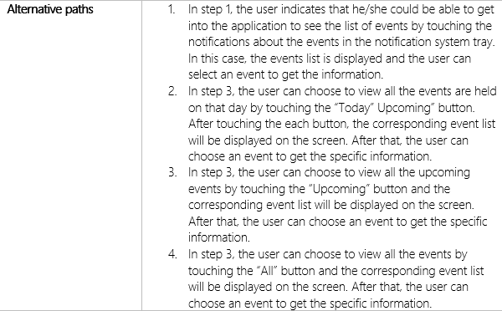
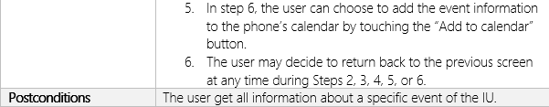
Getting Events info use case

Slide 9
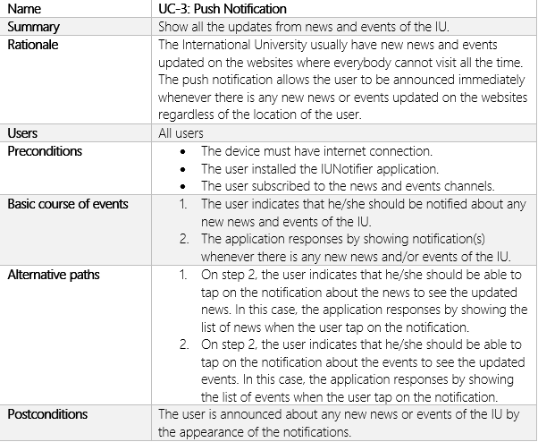
Push Notification use case

Slide 10
Development Note

Slide 11
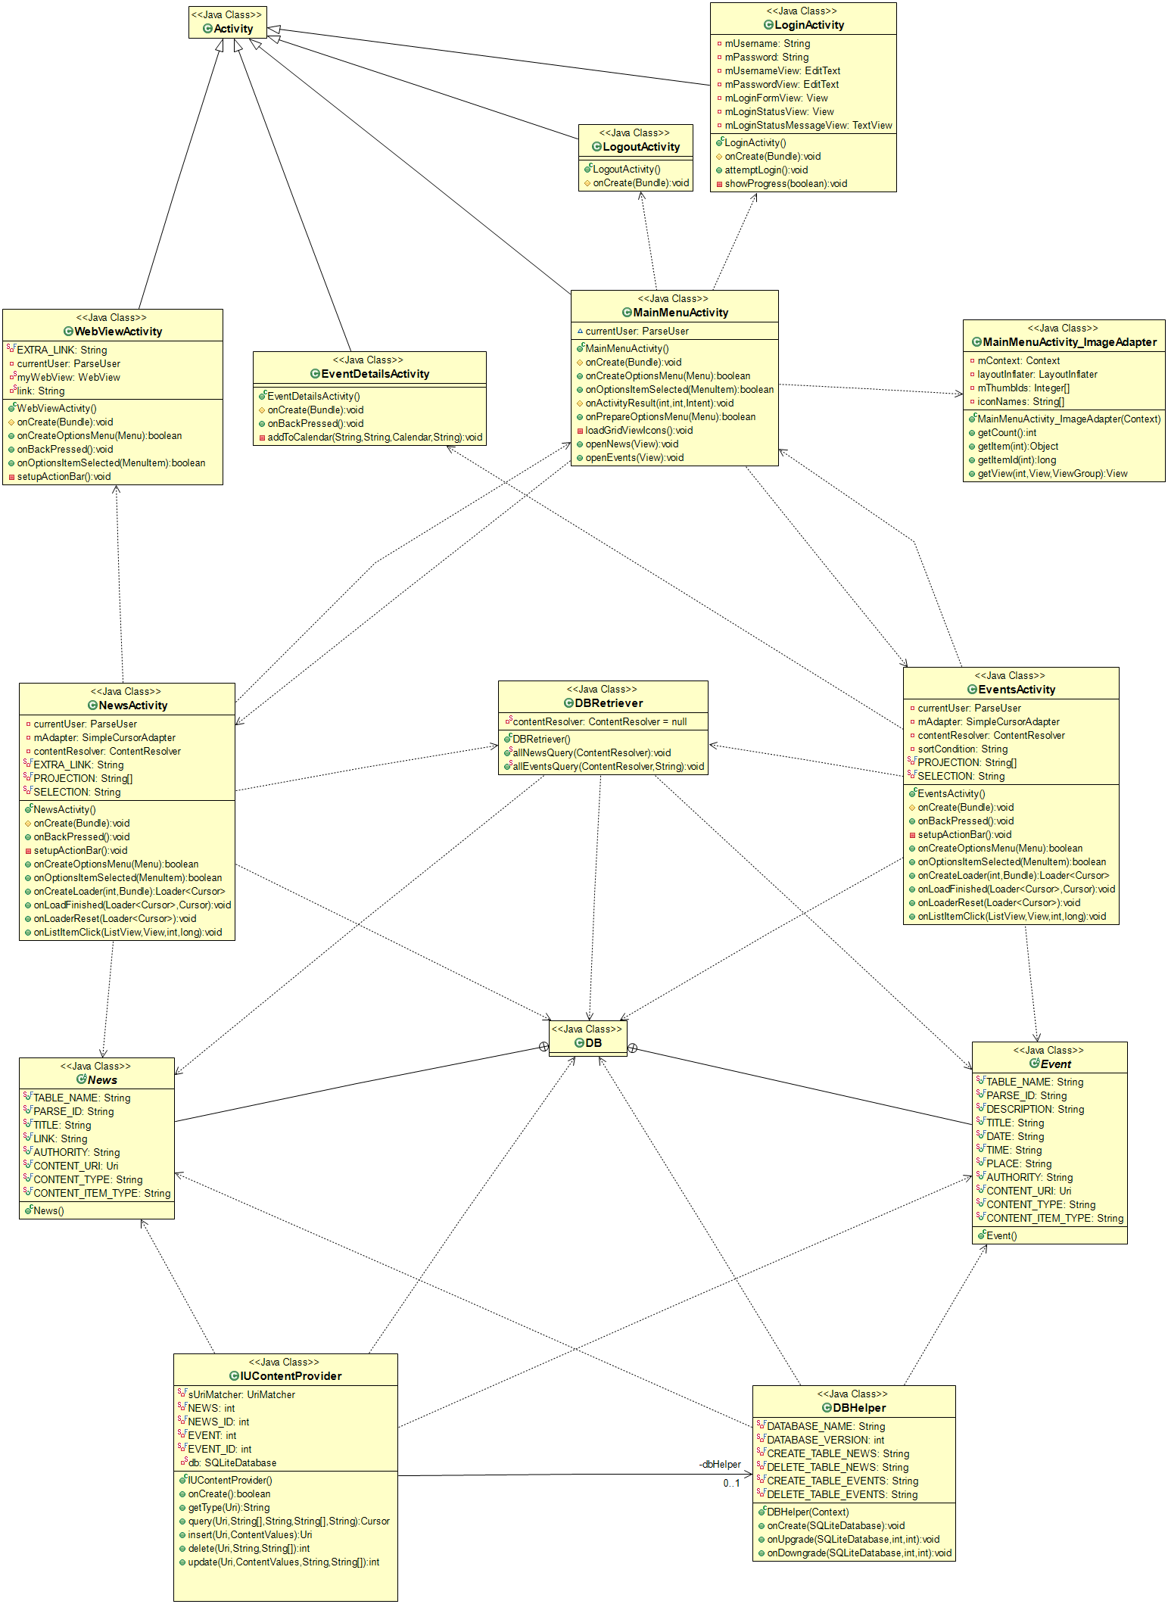
Class Diagram

Slide 12
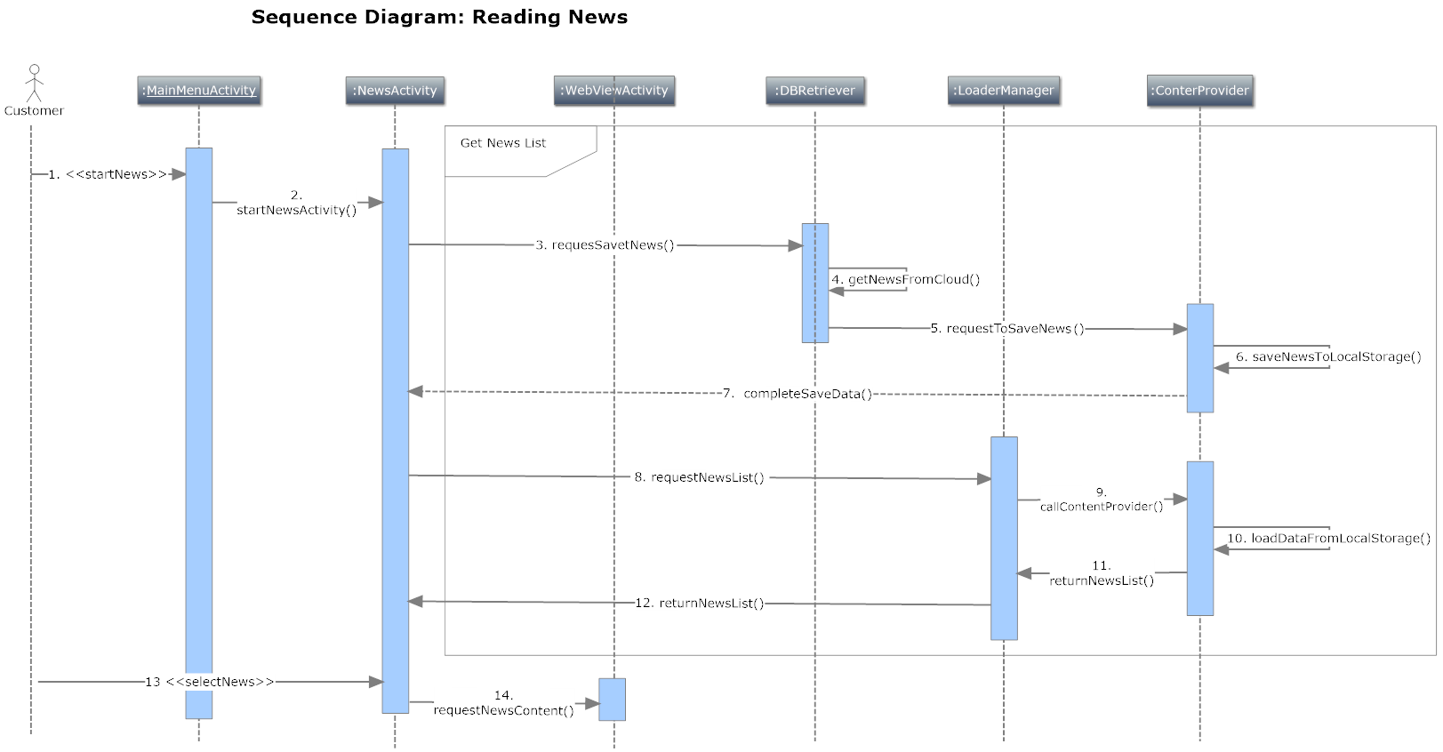
Sequence Diagram
Reading News
sequence diagram

Slide 13
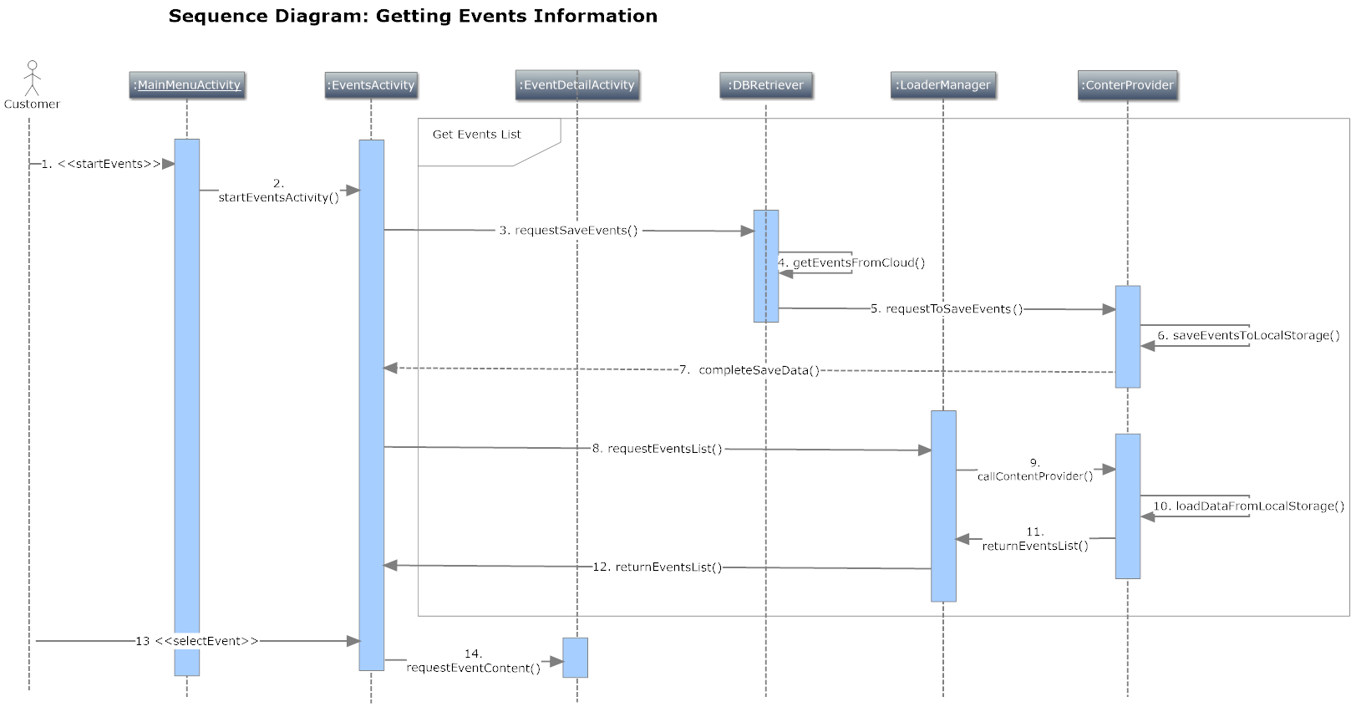
Sequence Diagram
Getting Events Information
sequence diagram

Slide 14
Sample Java Source

Slide 15
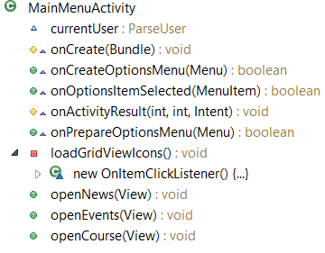
MainMenuActivity class
Class structure

Slide 16
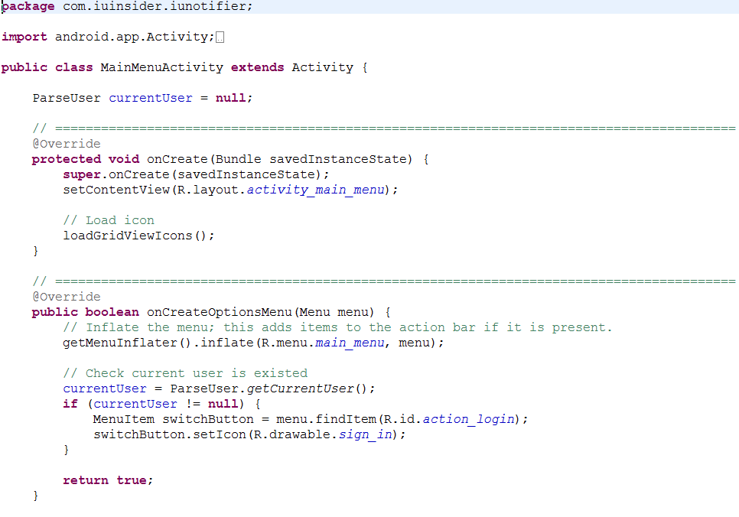
MainMenuActivity class
Source code

Slide 17
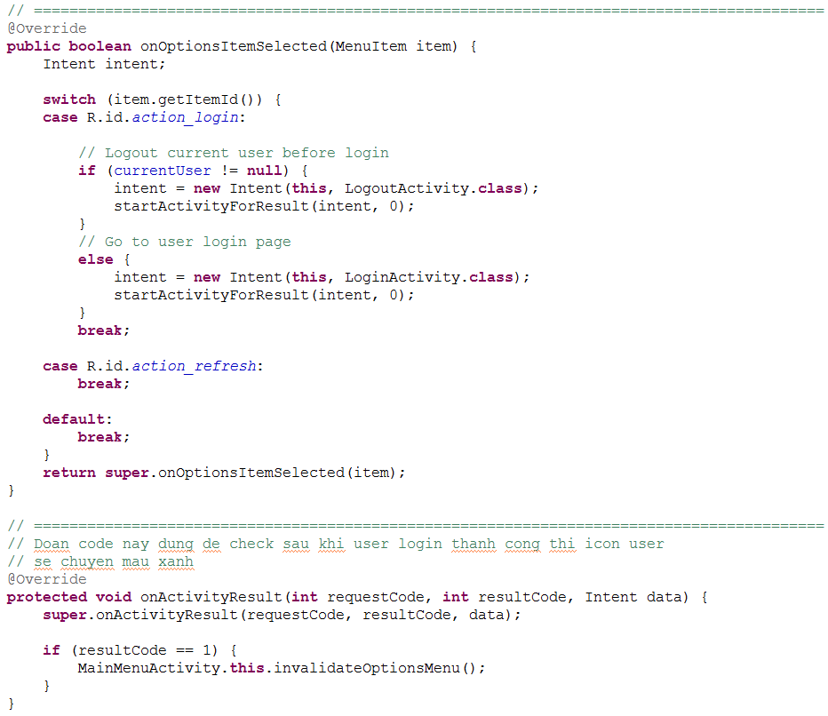
MainMenuActivity class
Source code

Slide 18
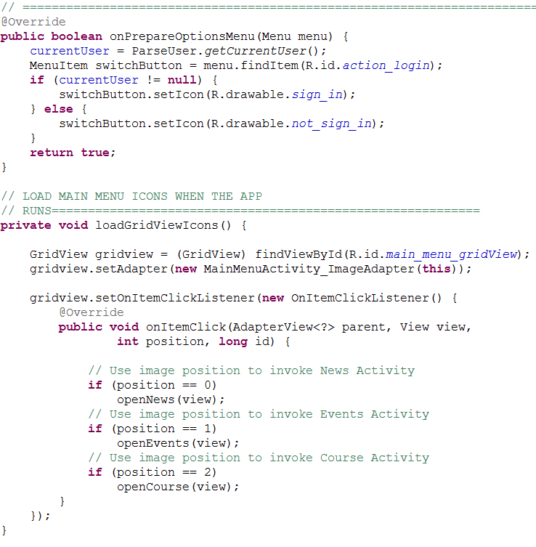
MainMenuActivity class
Source code

Slide 19
Sample Java Test Source

Slide 20
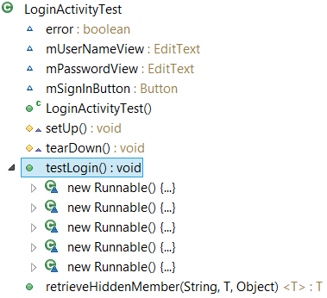
LoginActivityTest class
Class structure

Slide 21
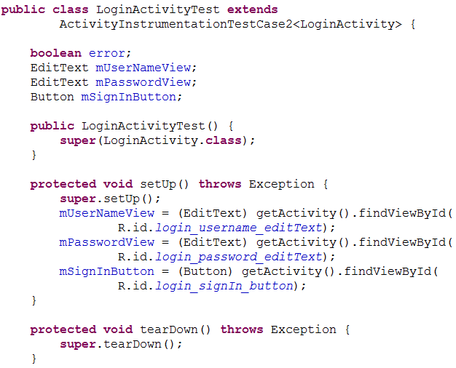
LoginActivityTest class
Source code

Slide 22
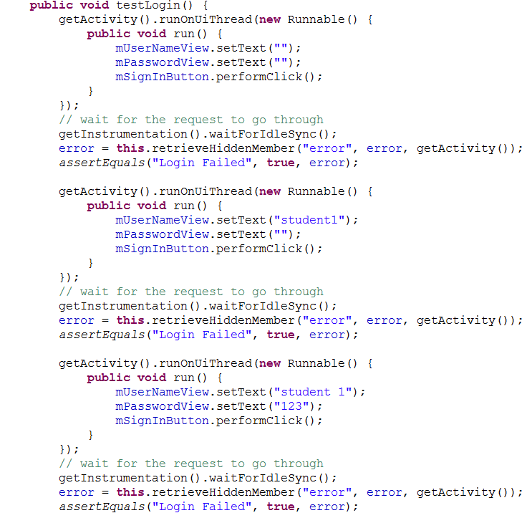
LoginActivityTest class
Source code

Slide 23
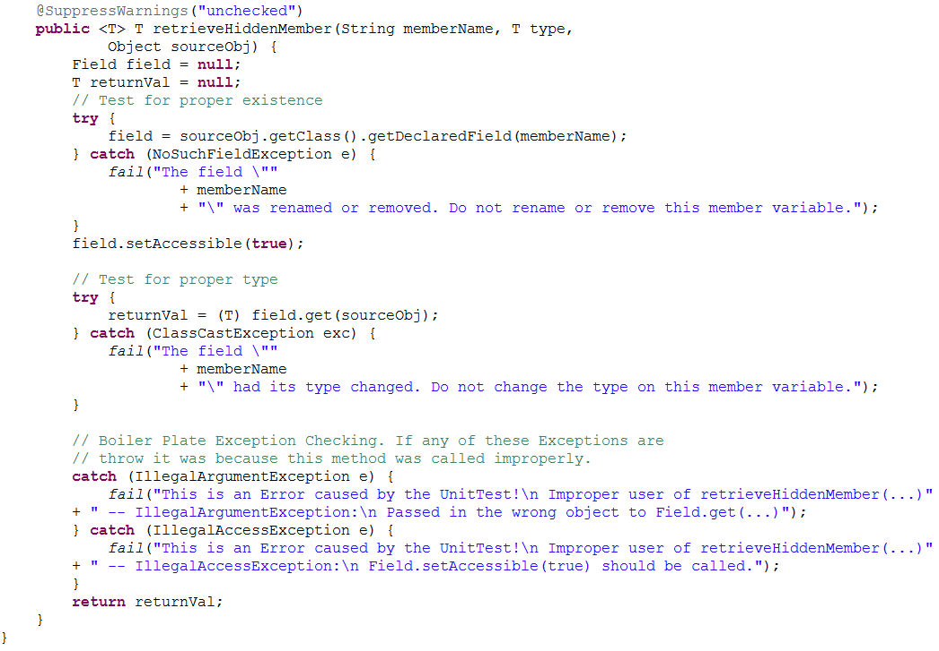
LoginActivityTest class
Source code

Slide 24
Demo

